Slide 1
Software Engineering I
Dr. Elham Mahmoudzadeh
Isfahan University of Technology
mahmoudzadeh@iut.ac.ir
2021

Slide 2
Chapter 8 Class and Method design

Slide 3
Steps(I)
Preparing proposal
Requirements determination
User story
Abstract Business Process Modelling
Analysis
Functional Modelling
Structural Modelling
Behavioral Modelling

Slide 4
Steps(II)
Design
Optimization
Database Management
User Interface
Physical Architecture

Slide 5
Design Criteria
A good design is one that balances trade-off s to minimize the total cost of the system over its entire lifetime.
Coupling
Cohesion

Slide 6
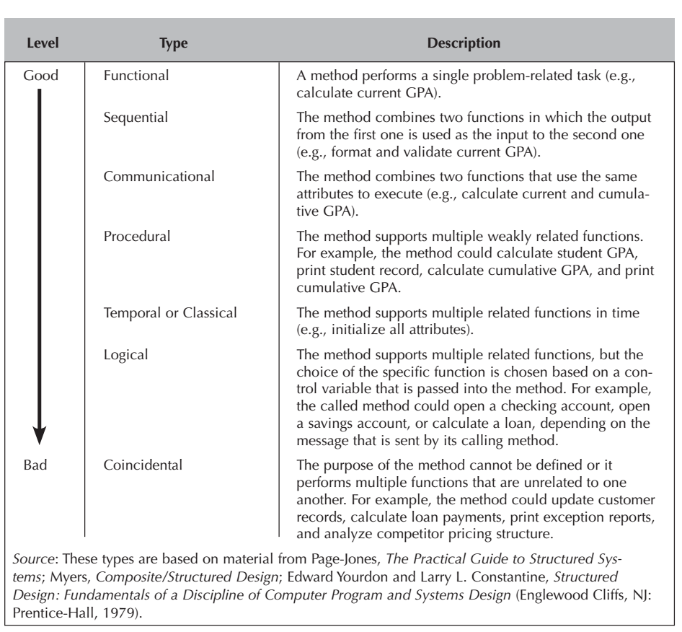
Types of method cohesion

Slide 7
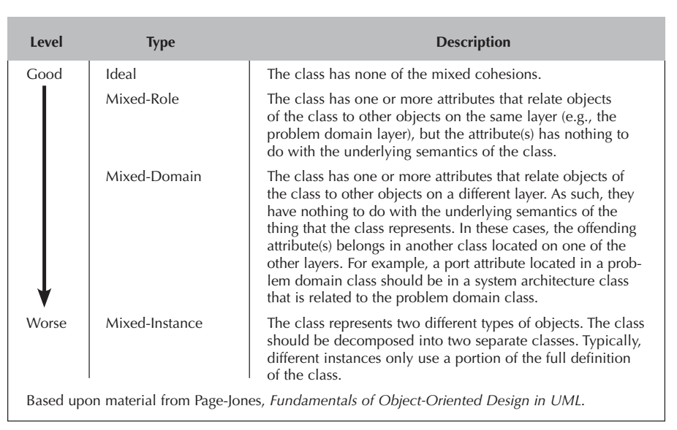
Types of class cohesion

Slide 8
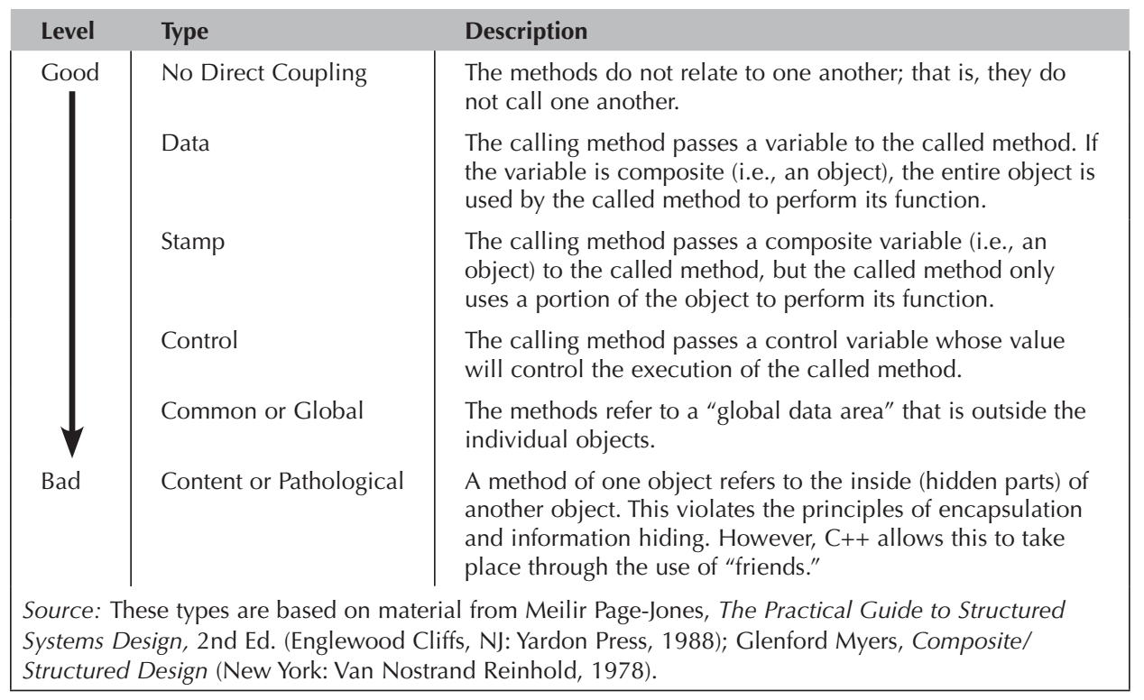
Types of interaction coupling

Slide 9
SOLID Principles
Single Responsibility (SRP)
Open-Close principle (OCP)
Liskov Substitution Principle (LSP)
Interface Segregation Principle (ISP)
Dependency Inversion Principle (DIP)

Slide 10
Open Closed Principle (OCP)
Classes should be open for extension but closed for modification.
OCP states that we should be able to add new features to our system without having to modify our set of preexisting classes.
Reduce the coupling between classes to the abstract level.
Instead of creating relationships between two concrete classes, we create relationships between a concrete class and an abstract class or an interface.
Interface is a shared boundary across which two or more separate components of a computer system exchange information.

Slide 11
Liskov Substitution Principle (LSP)
Subclasses should be substitutable for their base classes.
Subclasses should not limit their base classes, for example should not change “public” variable to “private”.

Slide 12
Interface Segregation Principle (ISP)
Many specific interfaces are better than a single, general interface.
Any interface we define should be highly cohesive.

Slide 13
Dependency Inversion Principle (DIP)
The structure of many older software architectures is hierarchical. At the top of the architecture, “control” components rely on lower-level “worker” components to perform various cohesive tasks.
Consider a simple program with three components. The intent of the program is to read keyboard strokes and then print the result to a printer. A control module, C, coordinates two other modules—a keystroke reader module, R, and a module that writes to a printer, W.
The design of the program is coupled because C is highly dependent on R and W. To remove the level of dependence that exists, the “worker” modules R and W should be invoked from the control module S using abstractions.
This slide is brought from: “R.G. Pressman, B. R. Maxim, Software Engineering_ A Practitioner’s Approach, 8th Edition, 2014”.

Slide 14
Dependency Inversion Principle (Cnt’d)
In object-oriented software engineering, abstractions are implemented as abstract classes, R* and W*. These abstract classes could then be used to invoke worker classes that perform any read and write function.
Therefore class, C, invokes abstract classes, R* and W*, and the abstract class points to the appropriate worker-class (e.g., the R* class might point to a read() operation within a keyboard class in one context and a read() operation within a sensor class in another. This approach reduces coupling and improves the testability of a design.
This slide is brought from: “R.G. Pressman, B. R. Maxim, Software Engineering_ A Practitioner’s Approach, 8th Edition, 2014”.

Slide 15
Dependency Inversion Principle (Cnt’d)
Depend upon abstractions. Do not depend upon concretions.
Formalizes the concept of abstract coupling and clearly states that we should couple at the abstract level, not at the concrete level.
High-level modules (classes) should not depend [directly] upon low-level modules. Both should depend on abstractions.
Abstractions should not depend on details. Details should depend on abstractions.

Slide 16
Adding Specifications for Object Design
There are no missing attributes or methods and no extra or unused attributes or methods in each class.
Finalize the visibility (hidden or visible) of the attributes and methods in each class.
Decide on the signature of every method in every class. The signature of a method comprises three parts: the name of the method, the parameters or arguments that must be passed to the method, and the type of value that the method will return to the calling method.
Any constraints that must be preserved by the objects.

Slide 17
Method Specification
General Information
Events
Message Passing
Algorithm Specifications

Slide 18
Reference
Dennis, Wixon, Tegarden, “System Analysis and Design, An Object Oriented Approach with UML”, 5th Edition, 2015.
R. G. Pressman, B. R. Maxim, Software Engineering_ A Practitioner’s Approach, 8th Edition, 2014.

